Slide 1
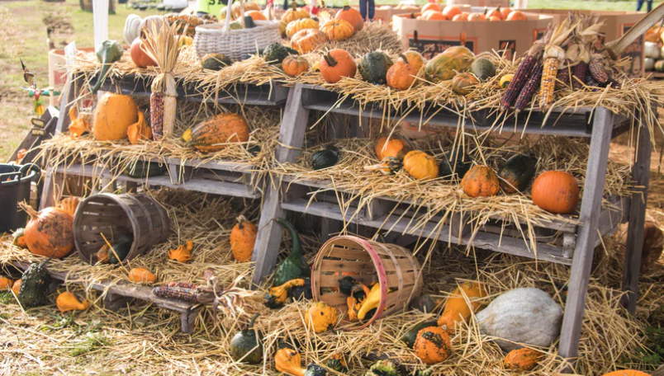
10 Lessons
Reading & Writing
about
Figurative Language
Just in time for Thanksgiving Break!
www.languageartsteachers.com

Slide 2
Personification gives human qualities to things that aren’t human.
It makes a THING seem more like a person so we can feel the impact of the writer’s message!

Slide 3
Personification helps us feel, see, or experience something in just the way the writer wants us to. Plus, it’s memorable. We remember things that create images for us.

Slide 4
#1
Gratitude makes sense of our past,
brings peace for today,
and creates a vision for tomorrow.
— Melodie Beattie

Slide 5
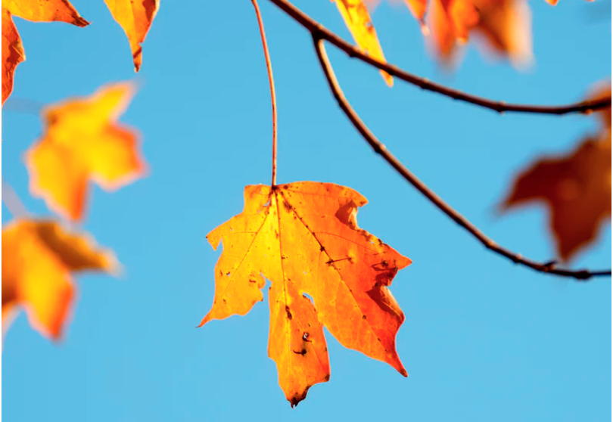
#2
“Let us be grateful to the people who make us happy; they are the gardeners who make our souls blossom.”
— Marcel Proust

Slide 6
Similes compare two unlike things using the words “like” or “as” to show how they’re similar.

Slide 7
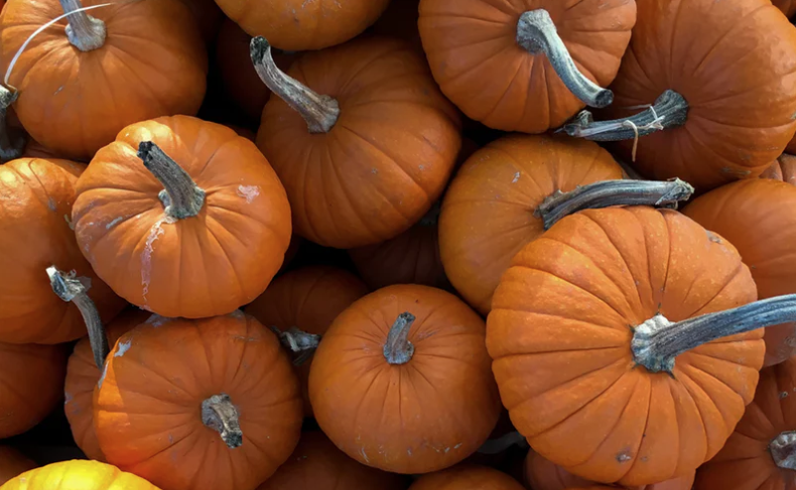
#3
"Feeling gratitude and not expressing it
is like wrapping a present and not giving it.”
-William Arthur Ward

Slide 8
#4
“It is autumn. The leaves are falling from the trees like burning tears- the wind howls.”
-Mervyn Peake

Slide 9
Similes are fine, it’s just that instead of saying that one thing is LIKE another thing, a metaphor intensifies the comparison by saying that one thing IS another thing!

Slide 10
#5
"Gratitude is riches. Complaint is poverty."
- Doris Day

Slide 11
#6
At times our own light goes out and is rekindled by a spark from another person. Each of us has cause to think with deep gratitude of those who have lighted the flame within us.
– Albert Schweitzer

Slide 12
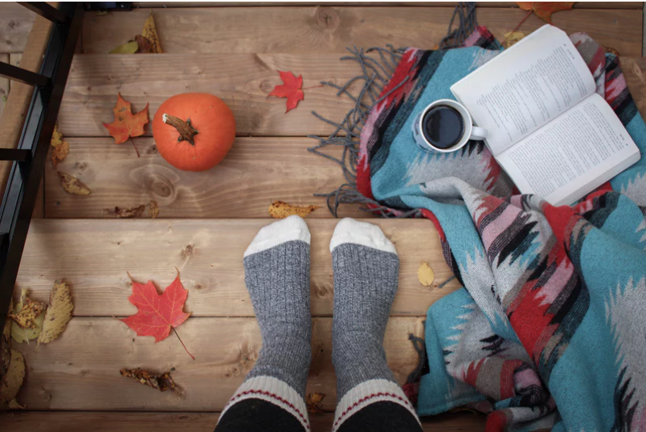
#7
“Gratitude is the open door to abundance.”
— Anonymous

Slide 13
Punctuation, like ellipses, can be very effective in causing the reader to pause and think. Ellipses can have a dramatic effect …when used correctly, that is!

Slide 14
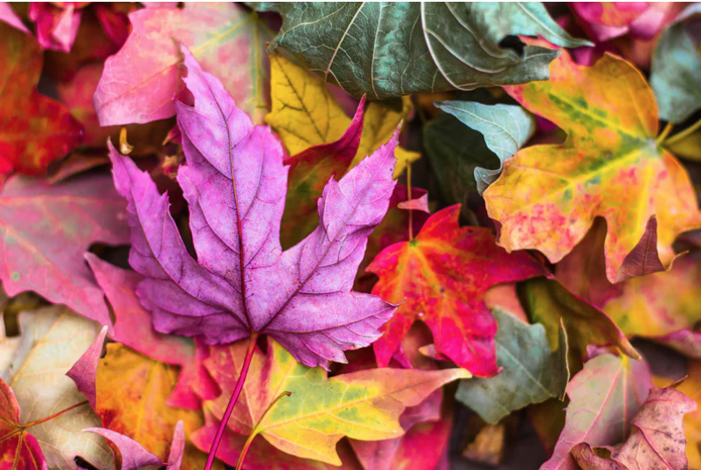
#8
“A thought about Thanksgiving Day: Once, there was this day… this one day when… everyone realized they needed each other. ”
— April Burns in “Pieces of April”

Slide 15
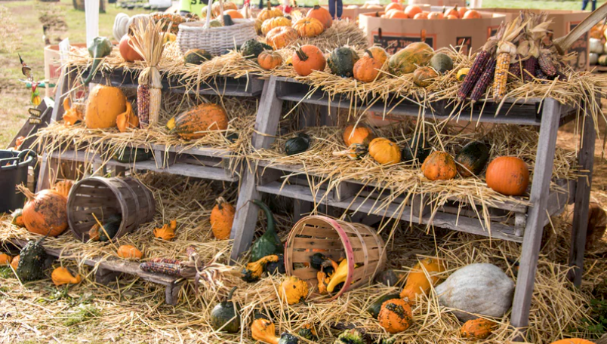
#9
“Thanksgiving isn’t just a day . . .
It’s a way we can live our lives
every day.”
— Katrina Mayer

Slide 16
Imagery is the use of sight, sound, touch, taste, or smell to create a picture in the reader’s mind that is so real, it’s like the reader is right there!

Slide 17
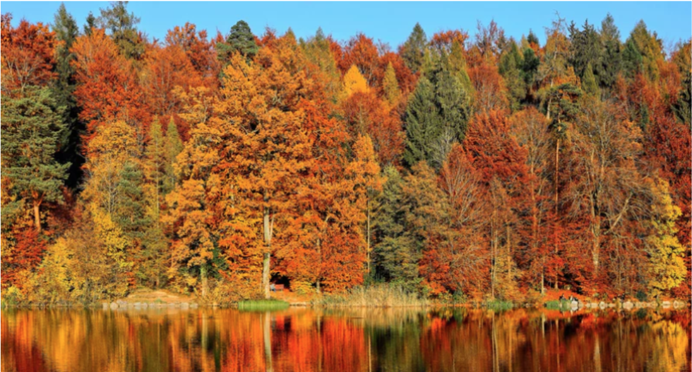
#10
“Autumn burns brightly, a running flame through the mountains, a torch flag to the trees.”
— Faith Baldwin

