Slide 1
November Autumn Setting
Use the following slide as a
Bell Ringer / Warm-Up / Do-Now activity
to start your class!

Slide 2
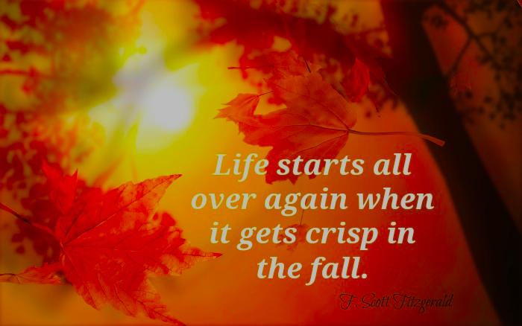
Copy the following quote. So beautiful! What does the author mean???

